Slide 1


Design Patterns
Decorator

Slide 2


Requisite Background Slide
“Reusable solution to a commonly occurring problem within a given context in software design” – Wikipedia
1987 – Kent Beck and Ward Cunningham, inspired by architectural pattern work, presented idea for software design patterns
1994 – “Gang of Four” published Design Patterns: Elements of Reusable Object-Oriented Software

Slide 3
Pattern Basics
Name
Type / Classification
(creational, structural, behavioral, concurrency)
Intent
Solution
Consequences

Slide 4
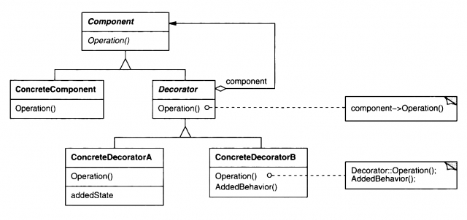
Decorator Pattern
type: structural
intent: “Attach additional responsibilities to an object dynamically. Decorators provide a flexible alternative to subclassing for extending functionality” (GOF)
Solution

Slide 5
Decorator Pattern
Examples
Common demos include adding logging or timing to methods (spoiler alert)
Stream decorators in C# - BufferedStream, CryptoStream, GZipStream
Pros
Runtime rather than compile time, more flexibility
Open / Closed Principle
Help deal with permutation issues
S | Single Responsibility Principle
O | Open / Closed Principle
L | Liskov Substitution Principle
I | Interface Segregation Principle
D | Dependency Inversion Principle

Slide 6

Decorator Pattern
Decorator 3
Decorator 2
Decorator 1
Base Object

Slide 7
Demo

Slide 8

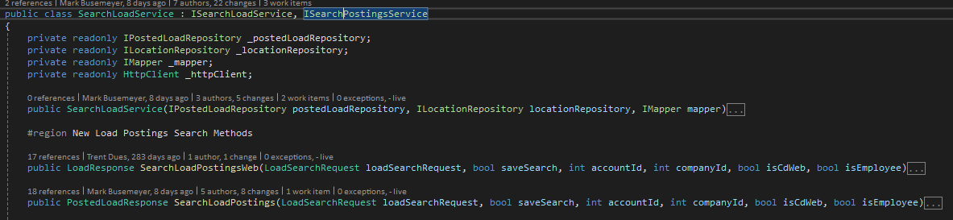
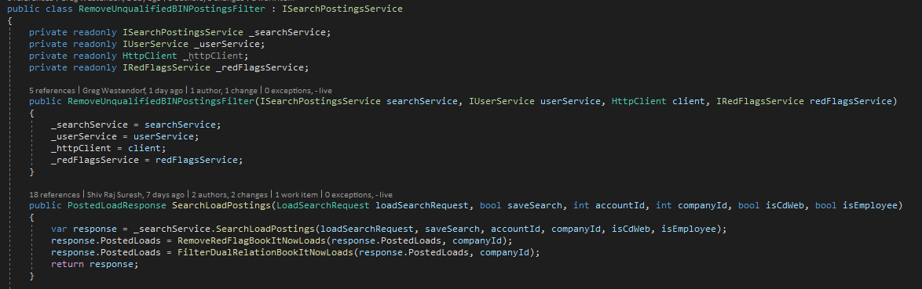
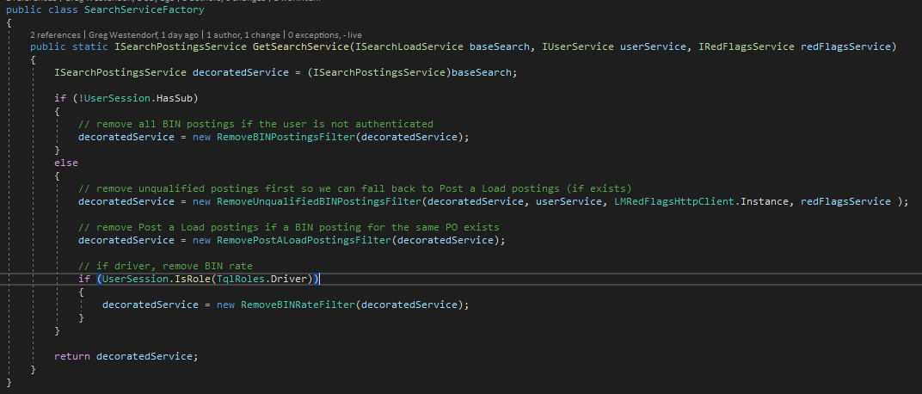
Real World Example

Slide 9
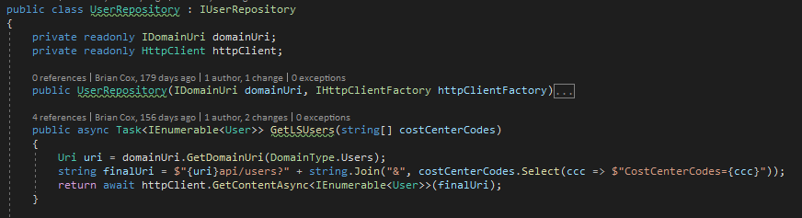
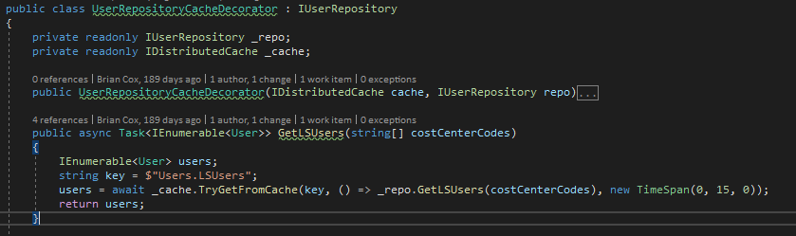
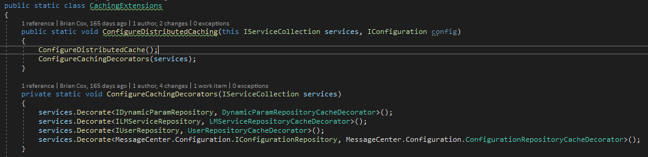
Real World Example – Part Deux

Slide 10
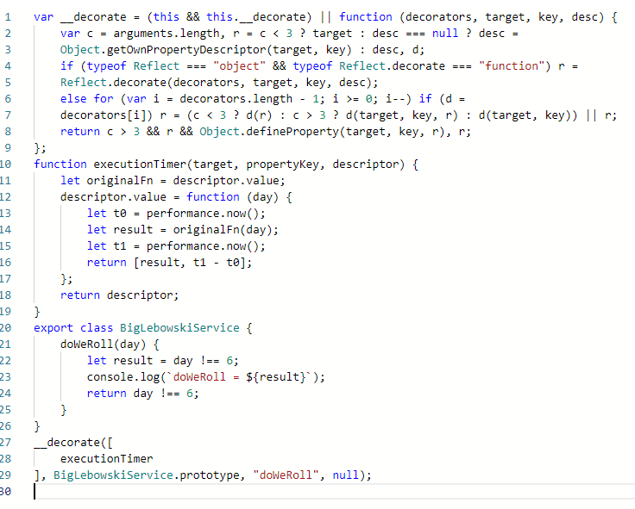
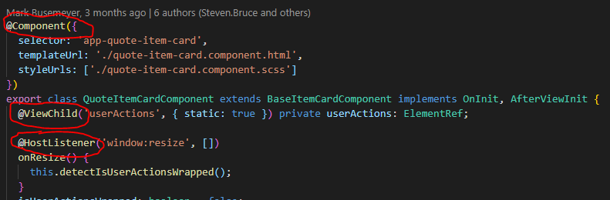
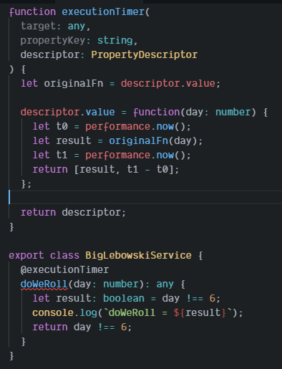
That’s cool, but What about front-end development?
https://codesandbox.io/s/typescript-decorator-example-fgriu

Slide 11
Consequences
Can lead to an explosion of small decorator classes making maintenance a challenge
Decorator usually coupled tightly to a specific class / interface so reuse can be a challenge

Slide 12
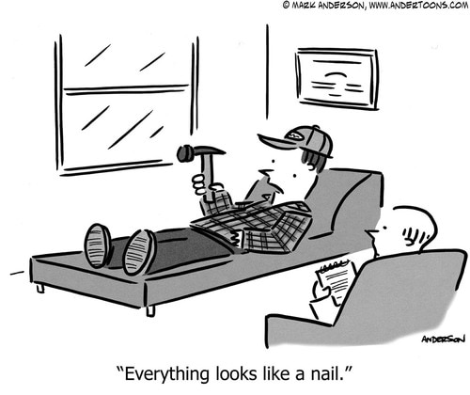
Disclaimer

Slide 13
resources
slides & c# example - https://github.com/BrianMCox/DecoratorExample
typescript example - https://codesandbox.io/s/typescript-decorator-example-fgriu

